Slide 1
What is big data? RNAseq in the context of big data
Traditional approaches don’t cover analysis requirements anymore in the big data era.
The (in)ability to do something with the data creates a gap

Slide 2
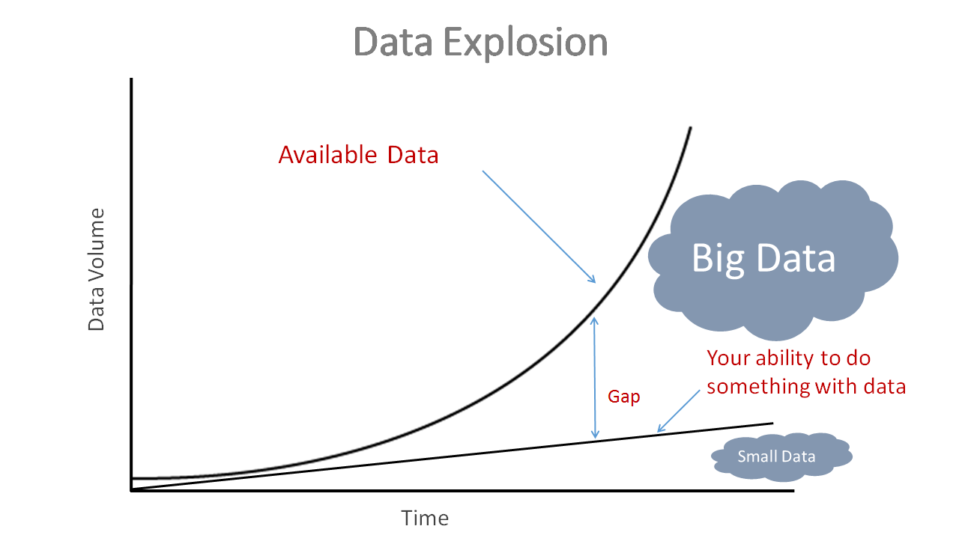
Your ability to do something with the data creates a gap

Slide 3
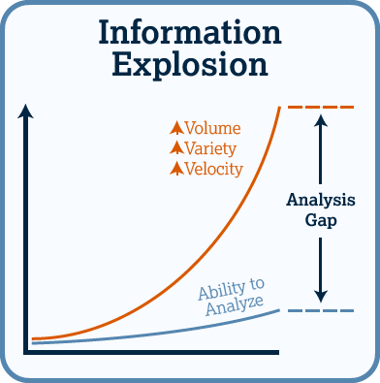

Slide 4
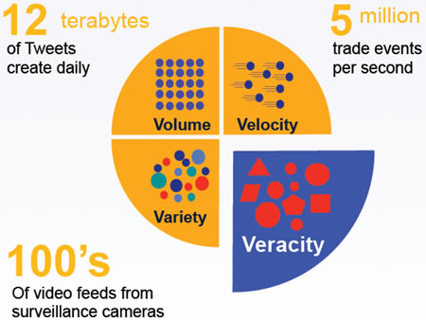
What makes big data ‘big’? Building up V’s

Slide 5
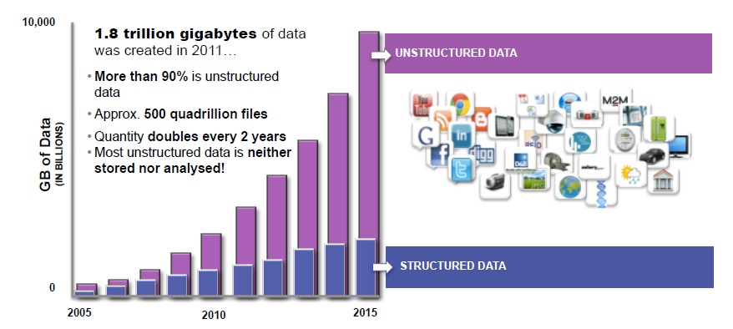
Big Data: mostly unstructured data https://www.slideshare.net/CiscoCanada/big-data-architecture-and-deployment
A zettabyte is one sextillion (one long scale trilliard) bytes. The unit symbol is ZB. 1 ZB = 1000⁷bytes = 10²¹bytes = 1000000000000000000000bytes = 1000exabytes = 1millionpetabytes = 1billionterabytes = 1trilliongigabytes.
Notes:
https://en.wikipedia.org/wiki/Zettabyte

Slide 6
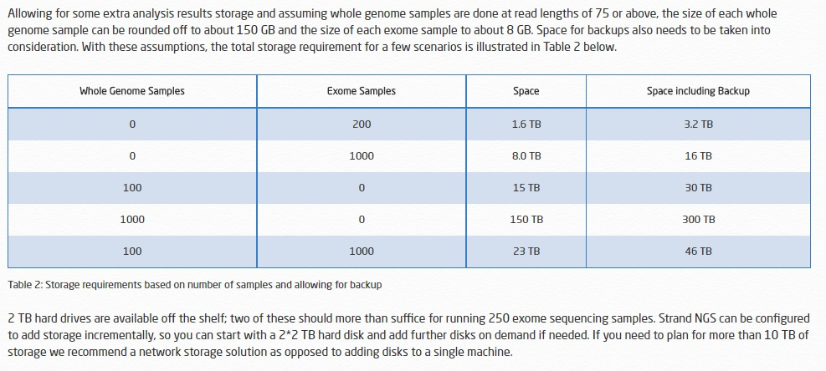
As comparison, RNAseq samples are in the order of magnitude of GB’s, similar to exome sequencing data
Notes:
http://www.strand-ngs.com/files/Strand_NGS_Guide_Storage_Computation_Requirements.pdf

Slide 7
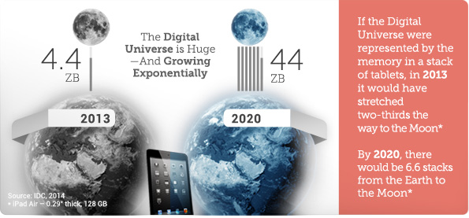
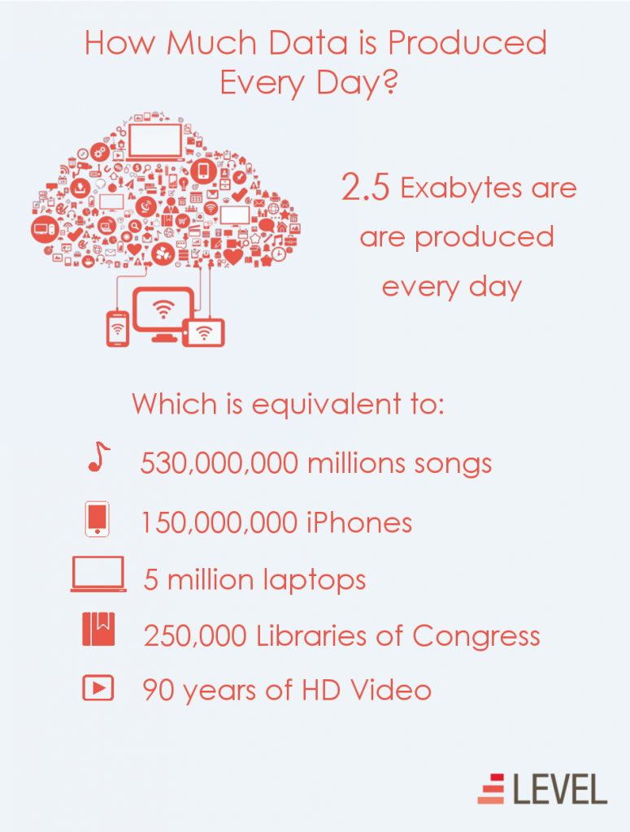
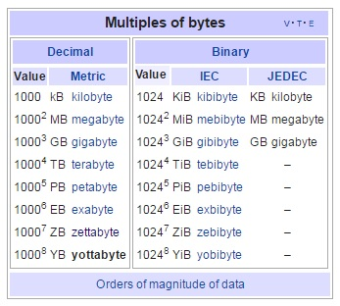
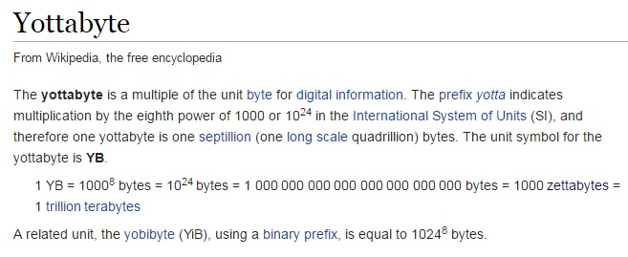
Notes:
https://en.wikipedia.org/wiki/Yottabyte

Slide 8
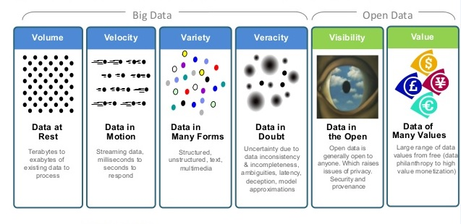
Not only size matters: 6 V’s

Slide 9
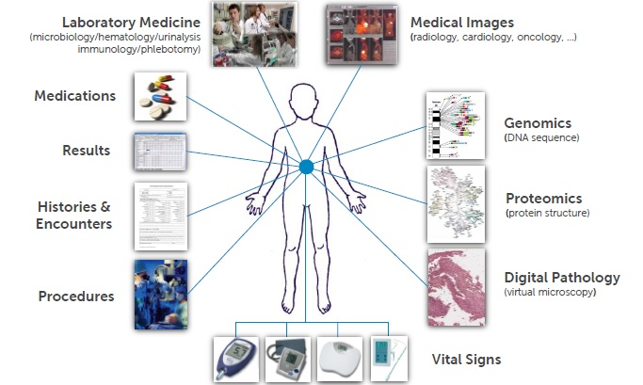
Where we want to go: The need for metadata / standardization

Slide 10
What is needed for integration?
Common standards are needed to connect the variety of different datasets
Metadata need to be automated, and made machine readable

Slide 11
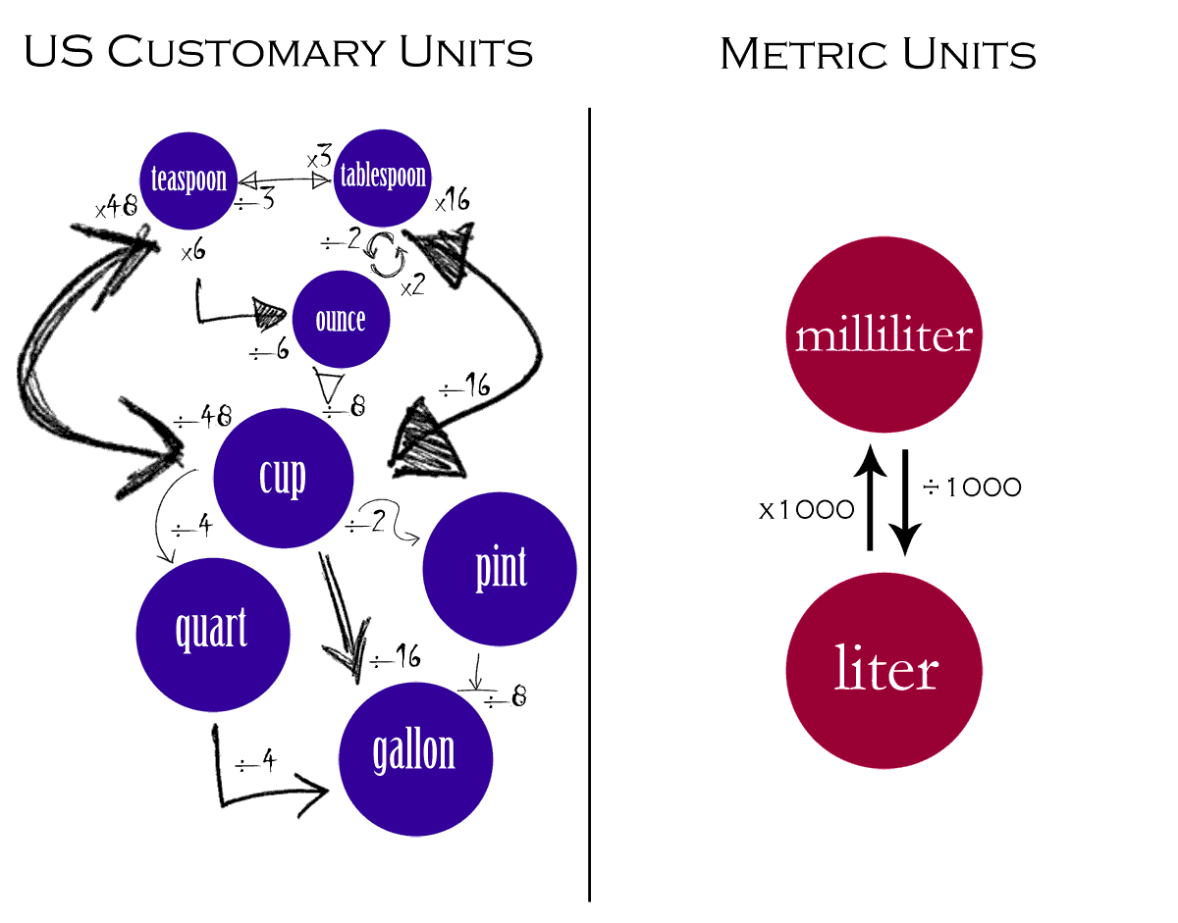
Making things comparable and easily convertible https://milebehind.wordpress.com/tag/u-s-customary-units/

Slide 12
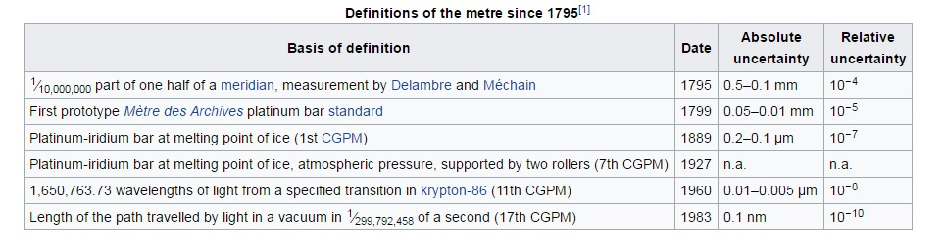
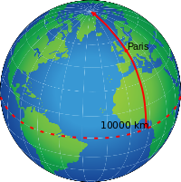
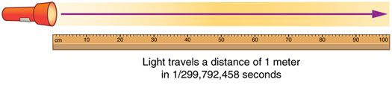
Technology updates: what is the current state of the art?

Slide 13
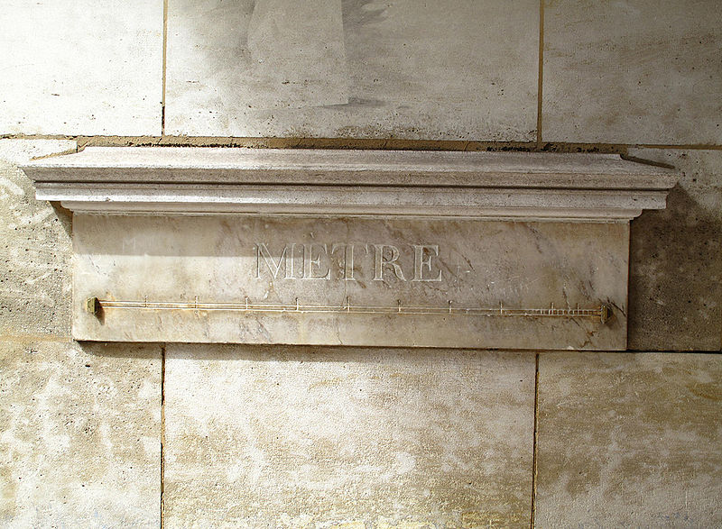
The need for a common reference is required for reproducibility

Slide 14
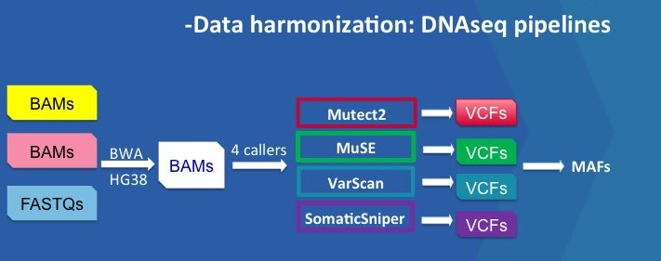
When is genomic data harmonized? Pipeline standardization
Notes:
https://gdc.cancer.gov/about-data/data-harmonization-and-generation/genomic-data-harmonization-0
https://topsy.one/hashtag.php?q=%23NCIGDC

Slide 15
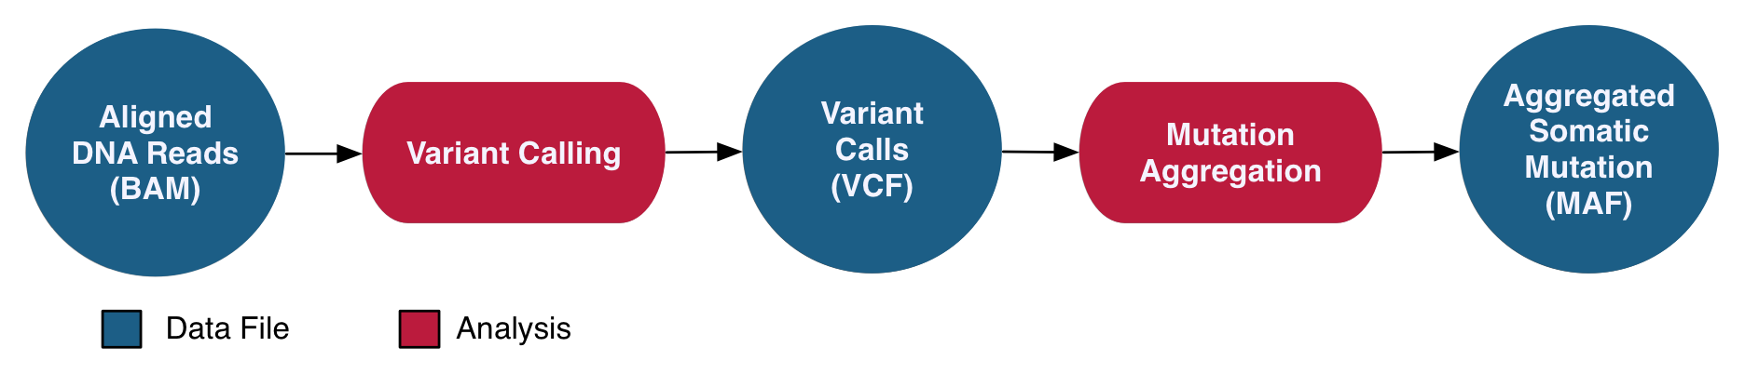
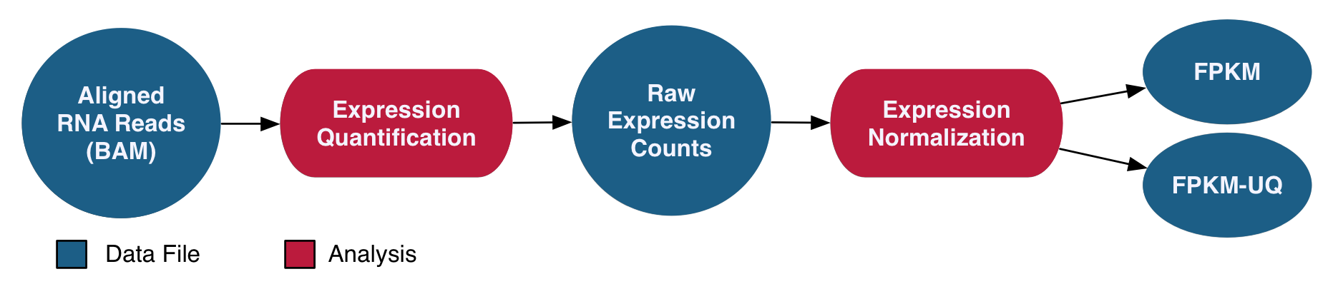
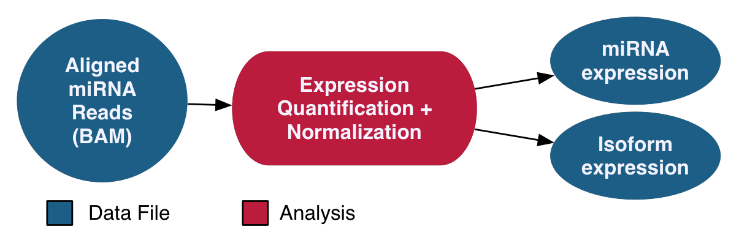
When is genomic data harmonized? Pipeline standardization in CWL: GA4GH
Notes:
http://www.bloodjournal.org/content/bloodjournal/130/4/453.full.pdf
https://www.slideshare.net/WarrenKibbe/nci-cancer-genomic-data-commons-for-ncab-september-2016

Slide 16
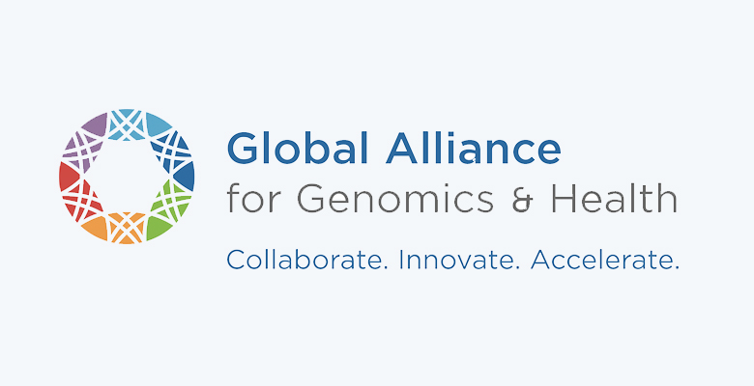
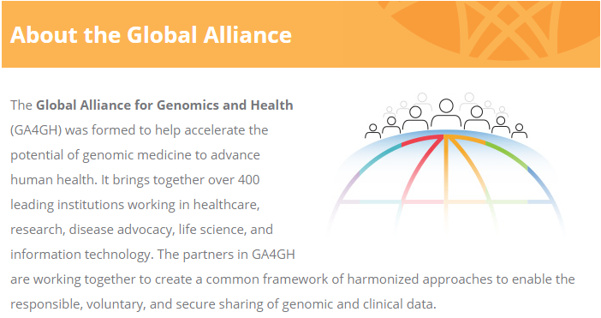
Notes:
http://genomicsandhealth.org/

Slide 17
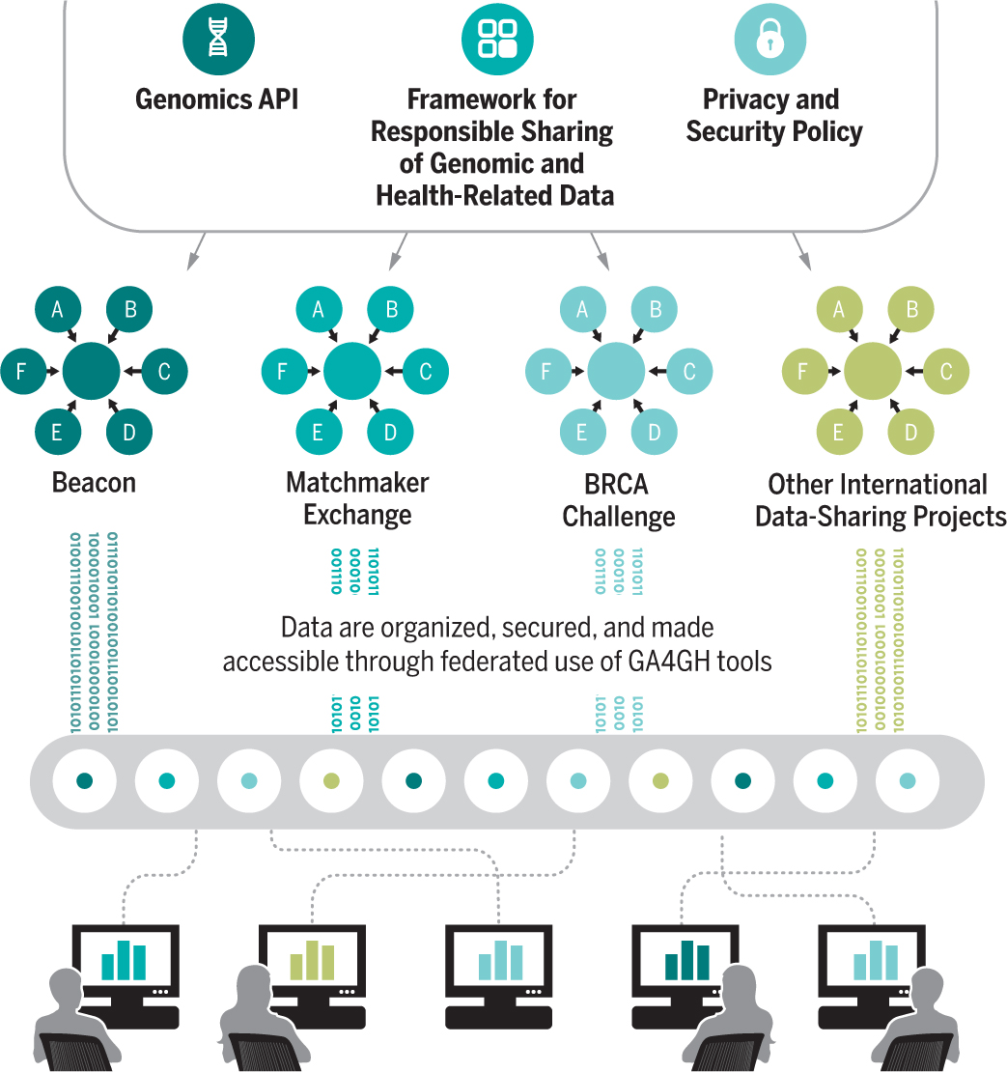
A federated data ecosystem
https://ucscgenomics.soe.ucsc.edu/federated-ecosystem-for-sharing-genomic-data/
The Global Alliance for Genomics and Health Science 2016;352:1278-1280
Notes:
A federated data ecosystem. To share genomic data globally, this approach furthers medical research without requiring compatible data sets or compromising patient identity.
http://science.sciencemag.org/content/352/6291/1278.full

Slide 18
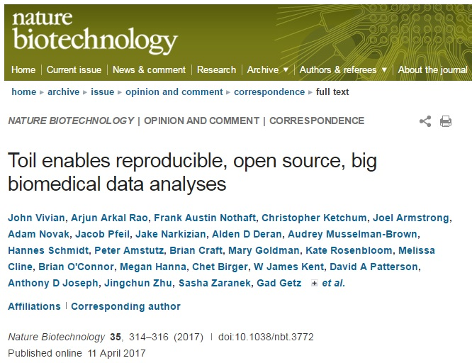
Toil enables reproducible, open source, big biomedical data analyses
Notes:
http://www.nature.com/nbt/journal/v35/n4/full/nbt.3772.html?WT.feed_name=subjects_biological-sciences&foxtrotcallback=true

Slide 19
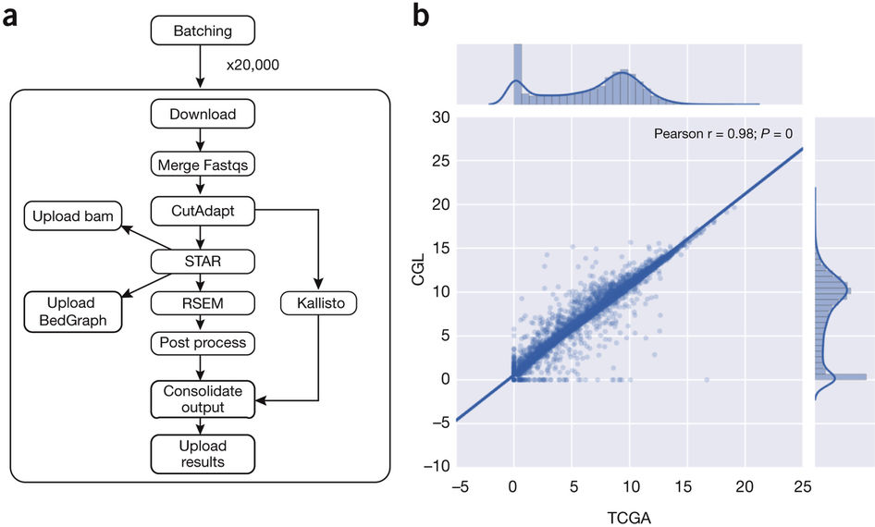
Toil enables reproducible, open source, big biomedical data analyses
Notes:
http://www.nature.com/nbt/journal/v35/n4/full/nbt.3772.html?WT.feed_name=subjects_biological-sciences&foxtrotcallback=true

Slide 20
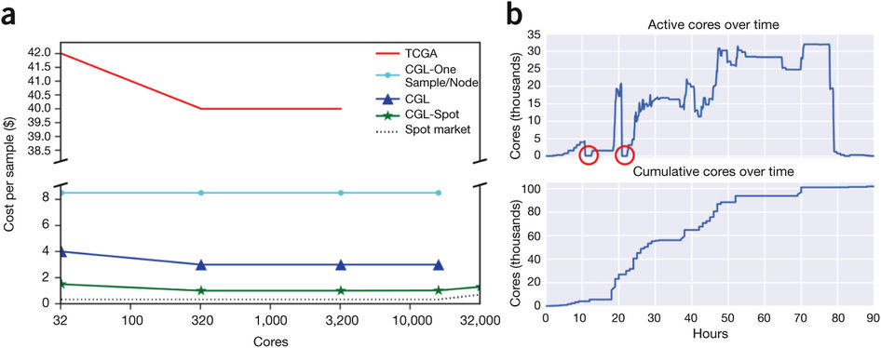
Toil enables reproducible, open source, big biomedical data analyses
Notes:
http://www.nature.com/nbt/journal/v35/n4/full/nbt.3772.html?WT.feed_name=subjects_biological-sciences&foxtrotcallback=true

Slide 21
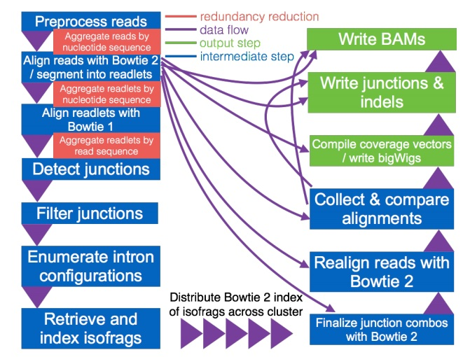
Rail-RNA to align 666 RNA-seq samples from the GEUVADIS project on Amazon Web Services in 12 hours for US$0.69 per sample
Notes:
Nellore A, Collado-Torres L, Jaffe AE, Morton J, Pritt J, Alquicira-Hernández J, Leek JT, Langmead B. (2015) Rail-RNA: Scalable analysis of RNA-seq splicing and coverage.
http://www.rna-seqblog.com/rail-rna-a-cloud-enabled-spliced-aligner-that-analyzes-many-samples-at-once/
http://www.biorxiv.org/content/early/2015/05/07/019067
http://rail.bio/

Slide 22
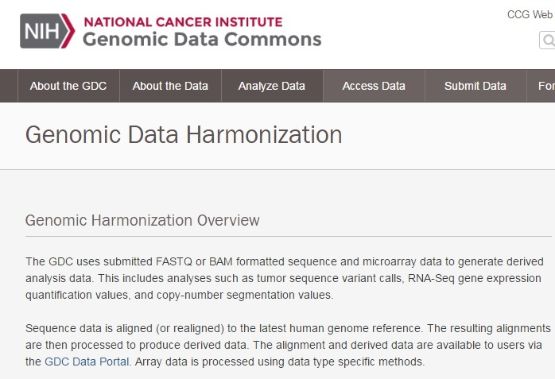
One example Genomic Data Harmonization by a genomic data commons
Notes:
https://gdc.cancer.gov/about-data/data-harmonization-and-generation/genomic-data-harmonization-0

Slide 23

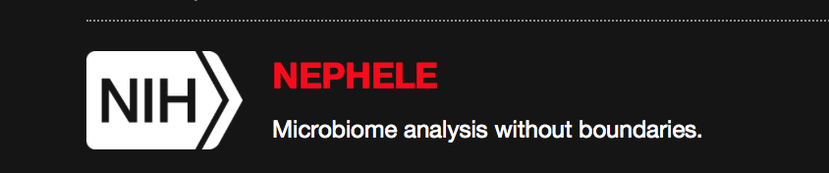


Multiple Data Commons’ are in existence

Slide 24
How to connect different data commons’s brings up several questions
What’s driving the need for a Data Commons?
Development of the Data Commons at NIH
Current Data Commons Pilots
Next steps
Considerations & Concluding Thoughts

Slide 25
A data commons underlies big data analytics & data science
NIH Data Commons
How do we find data, software, standards?
How can we make (large) data, annotations, software, metadata accessible?
How do we reuse data, tools and standards?
How do we make more data machine readable?
How do we leverage existing digital technologies systems, infrastructures?
How do we collaborate?
How do we enable digital ecosystem?

Slide 26



The Data Commons Framework
Software: Services & Tools
App store/User Interface
SaaS
scientific analysis tools/workflows
PaaS
Services: APIs, Containers, Indexing,
Digital Object Compliance
Data
“Reference” Data Sets
User defined data
Compute Platform: Cloud
IaaS
https://datascience.nih.gov/commons
Notes:
Detailed description of the Commons Framework can be found at : https://datascience.nih.gov/commons
https://datascience.nih.gov/TheCommons

Slide 27
Current Data Commons Pilots
Reference Data Sets
Making large and/or high impact NIH funded data sets and tools accessible in the cloud
Commons
Framework Pilots
Explore feasibility of the Commons Framework
Facilitate collaboration and interoperability
Resource Search & Index
Developing Data and Software indexing methods
Leveraging BD2K Efforts: bioCADDIE and others.
Collaborating with external groups
Cloud Credit Model
Provide access to cloud (IaaS) and PaaS/SaaS via credits
Connecting credits to the grants system
Notes:
https://commonfund.nih.gov/bd2k/commons

Slide 28
Mapping to the Commons Framework Large, High-Impact Datasets in the Cloud - Populating the Commons
Software: Services & Tools
App store/User Interface
scientific analysis tools/workflows
Services: APIs, Containers, Indexing,
Digital Object Compliance
Large, High-Impact Data Sets in the Cloud
Data
“Reference” Data Sets
User defined data
Compute Platform: Cloud or HPC
Notes:
Detailed description of the Commons Framework can be found at : https://datascience.nih.gov/commons
https://datascience.nih.gov/TheCommons

Slide 29
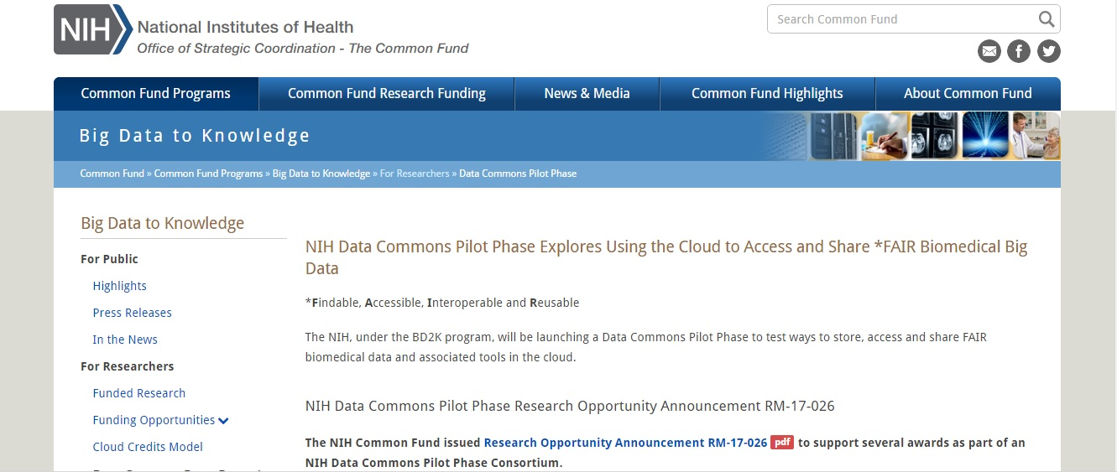
High value datasets in commons pilot
Notes:
https://commonfund.nih.gov/bd2k/commons

Slide 30
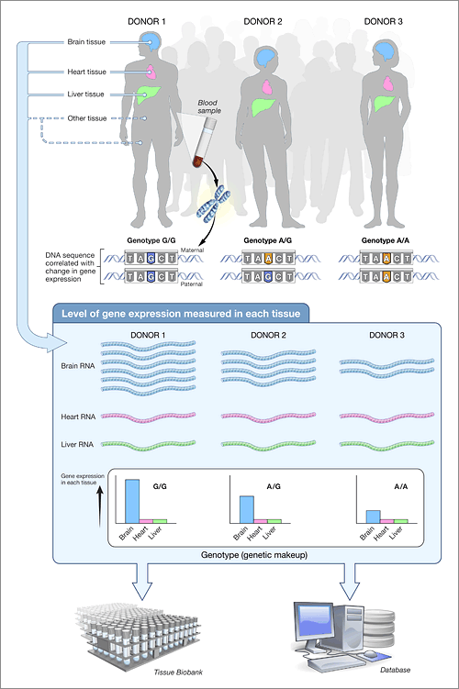
High value datasets in commons pilot: GtEx and TOPMED
Notes:
https://commonfund.nih.gov/bd2k/commons
https://www.gtexportal.org/home/
https://www.nhlbi.nih.gov/research/resources/nhlbi-precision-medicine-initiative/topmed

Slide 31
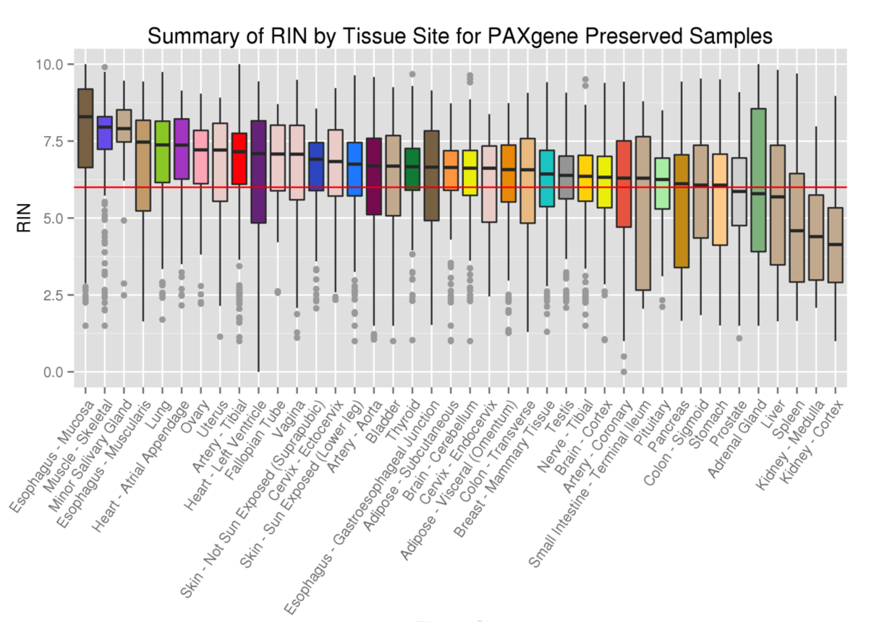
Notes:
https://commonfund.nih.gov/bd2k/commons
https://www.gtexportal.org/home/
https://www.nhlbi.nih.gov/research/resources/nhlbi-precision-medicine-initiative/topmed

Slide 32
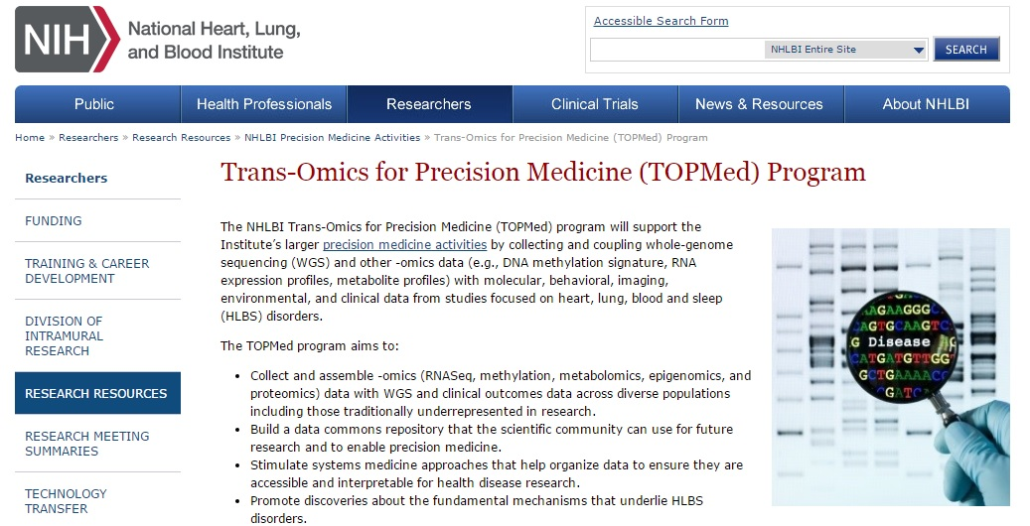
Notes:
https://commonfund.nih.gov/bd2k/commons
https://www.gtexportal.org/home/
https://www.nhlbi.nih.gov/research/resources/nhlbi-precision-medicine-initiative/topmed

Slide 33
Proposed Components: Large, High-Impact Datasets in the Cloud
Biomedical data resources and tools
Support to migrate large, high-impact datasets and associated tools into multiple cloud providers
Data and tools sets must be FAIR
Cloud Infrastructure
Support for cloud storage and architectural engineering to support data and tools
Coordination
Facilitate activities across the biomedical data resources and cloud providers
Development of market place/app store approaches
Auth: Authorization & Access controls
Tracking metrics (cost, usage etc.) and impact of the overall project

Slide 34
Framework: Large, High-Impact Datasets in the Cloud - Populating the Commons
This pilot project will inform NIH on:
Which Clouds are most functional, practical, and cost effective?
What is involved in moving data resources to the Cloud?
What will it cost?
How to manage challenges associated with both open access and controlled access data?
How do we find data and resources across clouds?
How do we compute across clouds?

Slide 35
Mapping to the Commons Framework Large, High-Impact Datasets in the Cloud - Populating the Commons
Software: Services & Tools
App store/User Interface
scientific analysis tools/workflows
Indexing
Services: APIs, Containers, Indexing,
Digital Object Compliance
Data
“Reference” Data Sets
User defined data
Compute Platform: Cloud or HPC
Notes:
Detailed description of the Commons Framework can be found at : https://datascience.nih.gov/commons
https://datascience.nih.gov/TheCommons

Slide 36
The Data Commons is a framework that supports FAIR data access and sharing and fosters the development of a digital ecosystem
https://datascience.nih.gov/commons
Notes:
https://commonfund.nih.gov/bd2k

Slide 37
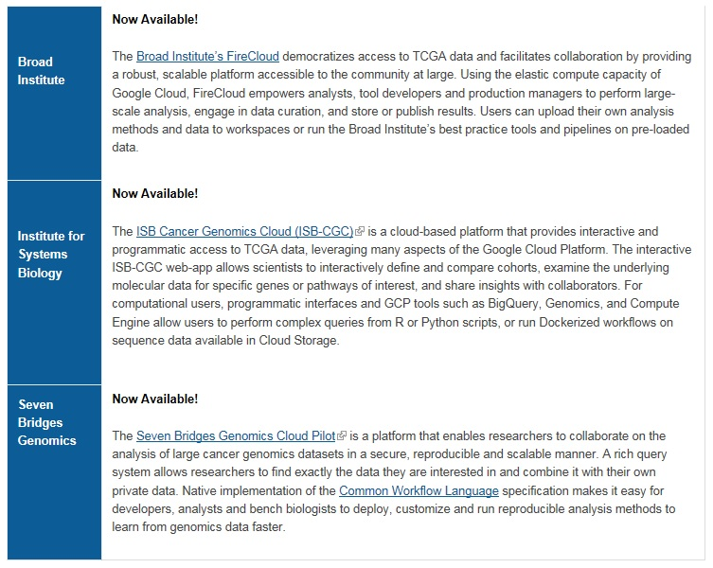
Three available Cloud Pilot Platforms
Notes:
https://www.slideshare.net/SteveTsang3/the-cancer-genomics-cloud-cgc-pilots-nih-ic-show-and-tell

Slide 38
Mapping to the Commons Framework Large, High-Impact Datasets in the Cloud - Populating the Commons
Software: Services & Tools
App store/User Interface
scientific analysis tools/workflows
Services: APIs, Containers, Indexing,
Digital Object Compliance
Data
“Reference” Data Sets
User defined data
Compute Platform: Cloud or HPC
Cloud architectures
Notes:
Detailed description of the Commons Framework can be found at : https://datascience.nih.gov/commons
https://datascience.nih.gov/TheCommons

Slide 39
Challenges Common to all three Cloud Pilots
Unify across Core datasets
Make Use Cases for pilots
Running preloaded pipeline on TCGA data
Uploading and processing user data
Uploading and running custom algorithms
Serve both biologists and bioinformaticians
Find common Workflow Language
Common Workflow Language (CWL) is being considered
Make Docker containers run across platforms
For improved portability and reproducibility
Using emerging GA4GH standards
Authorization and Authentication process

Slide 40
Broad Cloud Pilot
PI: Gad Getz
Collaborators: University California Berkeley, University California Santa Cruz
Cloud Platform: Google
Unique Technologies Used: ADAM/Spark
Tools Incorporated: Firehose
Cloud Pilot Website: http://firecloud.org

Slide 41
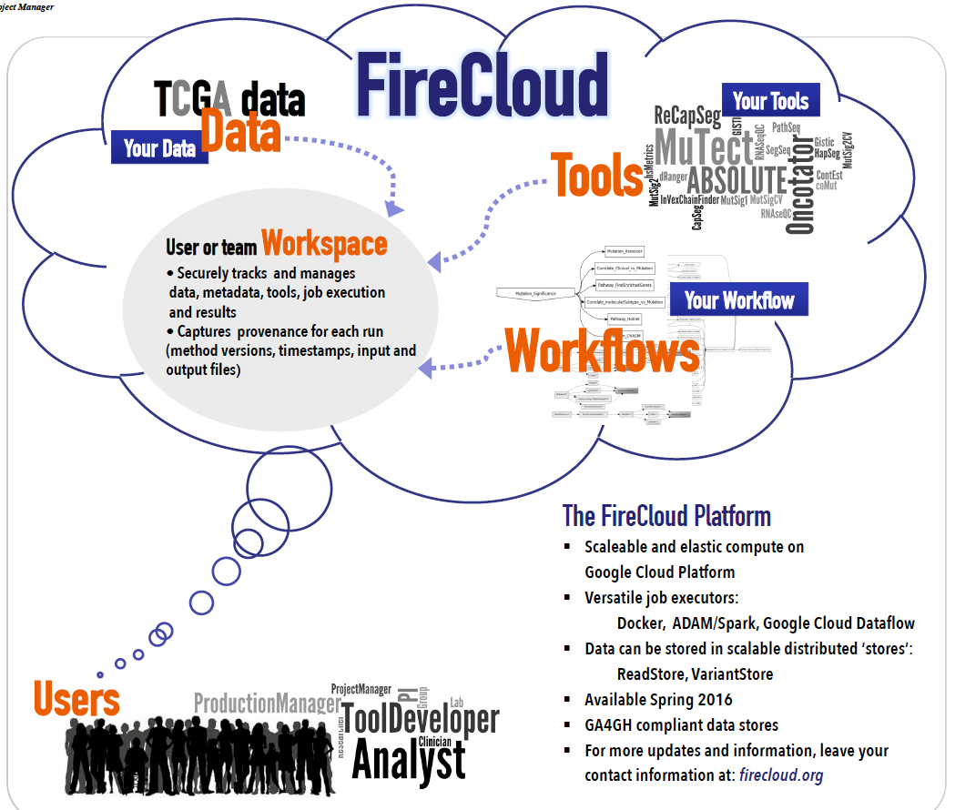
Notes:
https://cbiit.cancer.gov/ncip/nci-cancer-genomics-cloud-pilots/history-of-cancer-cloud-pilots-project

Slide 42
Institute for Systems Biology (ISB) Cloud Pilot
PI: Ilya Shmulevich
Collaborators: Google, SRA International
Cloud Platform: Google
Unique Technologies Used: Google Genomics Platform
Tools Incorporated: Regulome explorer, Gene Spot
Focus on interactive data visualization, exploration and analysis
Cloud Pilot Website: http://cgc.systemsbiology.net/

Slide 43
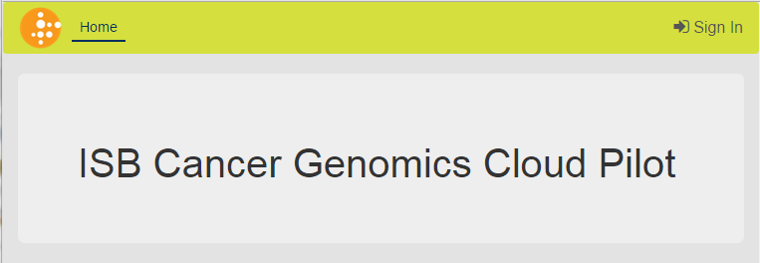

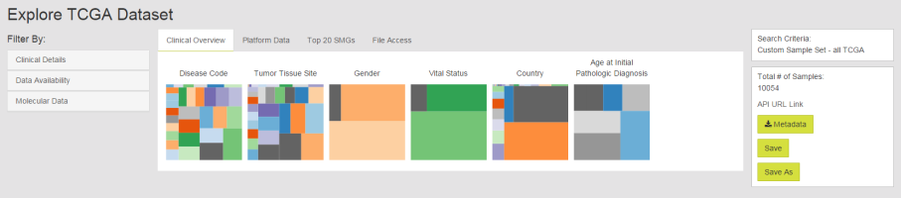
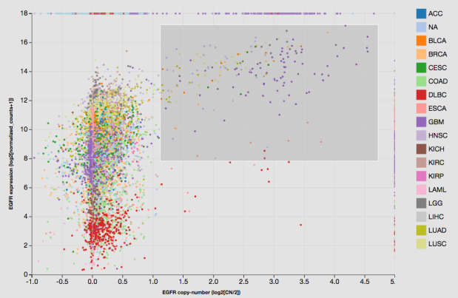
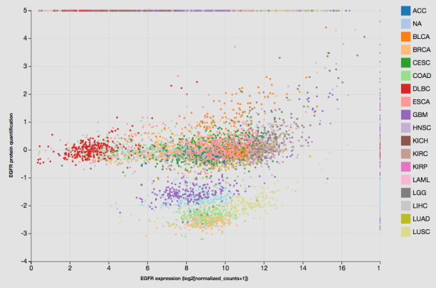
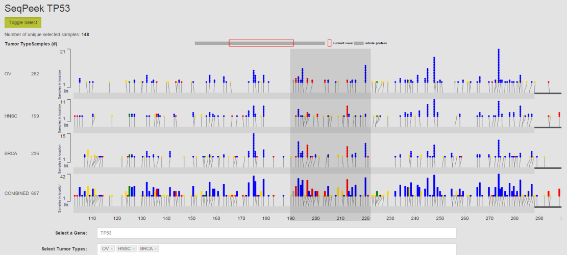
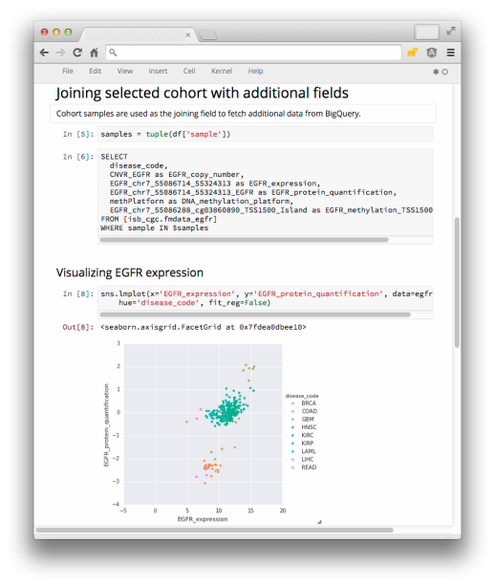
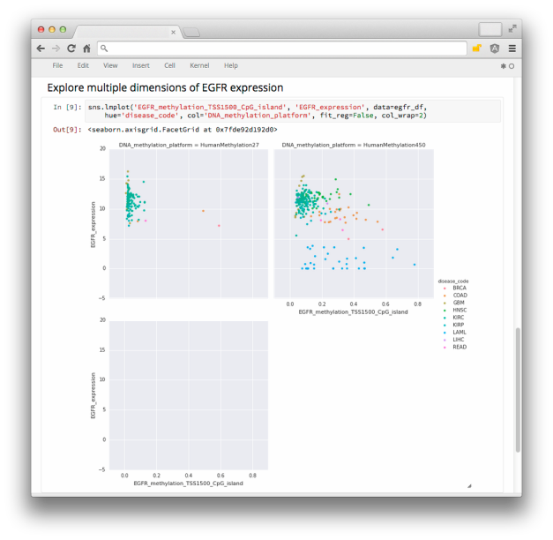
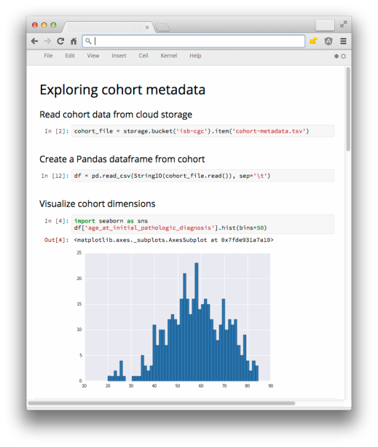
Interactive tools
explore all tumors or a subset
define custom “cohorts”
focus on specific molecular data types or platforms
Programmatic access
REST APIs for Cloud Storage
SQL-like queries for BigQuery
GA4GH API for Google Genomics
Tutorials
IPython notebooks
RStudio (Rmd) files
Notes:
https://cbiit.cancer.gov/ncip/nci-cancer-genomics-cloud-pilots/history-of-cancer-cloud-pilots-project

Slide 44
Seven Bridges Genomics Cloud Pilot
PI: Deniz Kural
Collaborators: None
Cloud Platform: Amazon Web Services
Unique Technologies Used: SBG platform
Tools Incorporated: > 30 public pipelines
https://igor.sbgenomics.com/lab/public/pipelines/
Cloud Pilot Website: http://www.cancergenomicscloud.org

Slide 45
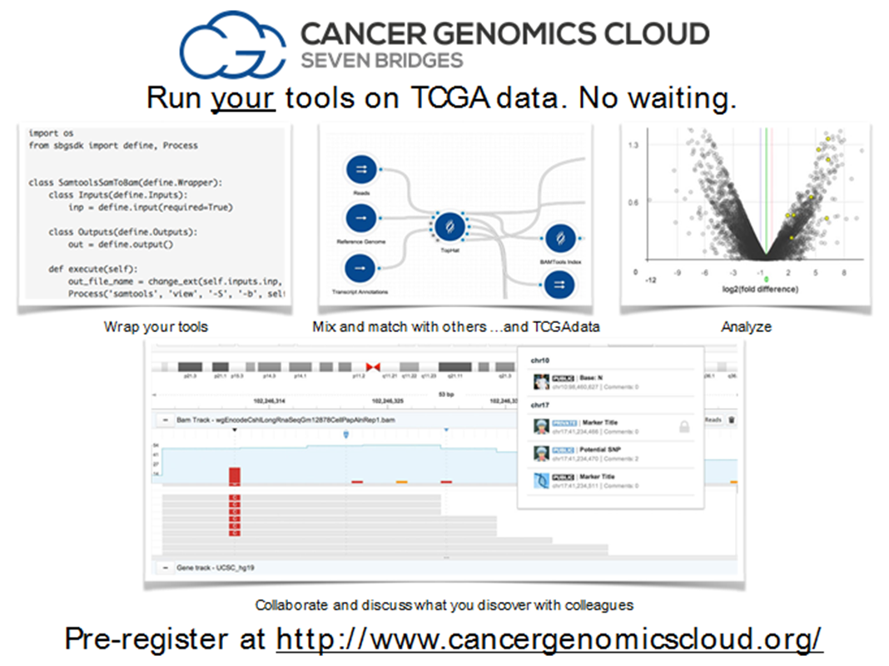
Notes:
https://cbiit.cancer.gov/ncip/nci-cancer-genomics-cloud-pilots/history-of-cancer-cloud-pilots-project

Slide 46
Challenges: NCI GDC and the Cloud Pilots
§▪ get working groups together to build common APIs
§▪ Have groups work with the Global Alliance for Genomics and Health (GA4GH) to define the next generation of secure, flexible, meaningful,
interoperable, lightweight interfaces
§▪ have groups competing on the implementation, collaborating on the interface
§▪ Aligning with NIH BD2K Program and serving as a part of the NIH
Commons and working toward shared goals of FAIR (Findable,
Accessible, Interoperable, Reusable)
§▪ have groups exploring and defining sustainable precision medicine information infrastructure

Slide 47
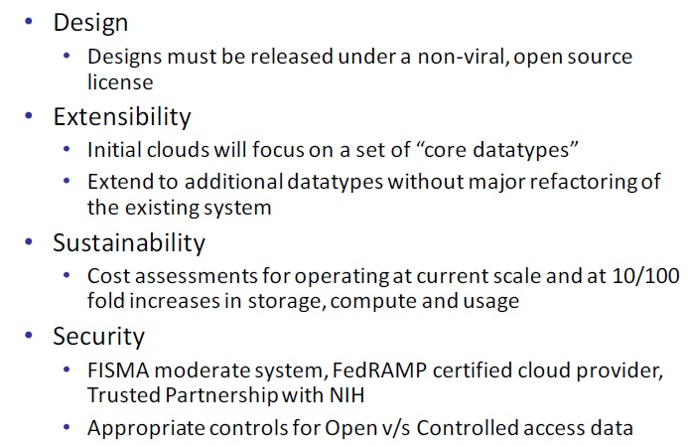
Cloud pilot requirements: challenges

Slide 48
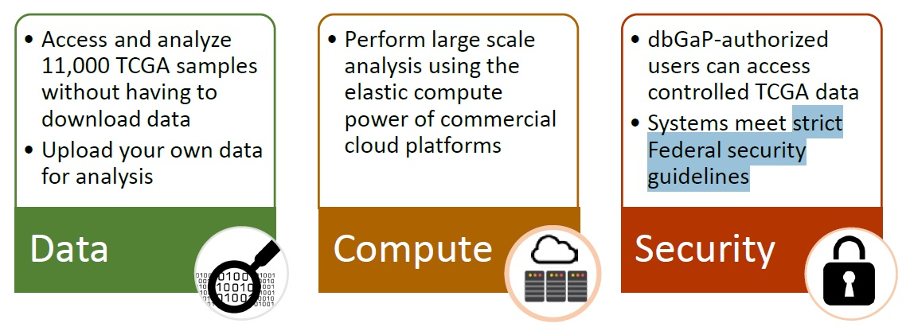
Challenges
Notes:
https://cbiit.cancer.gov/ncip/nci-cancer-genomics-cloud-pilots/history-of-cancer-cloud-pilots-project

Slide 49
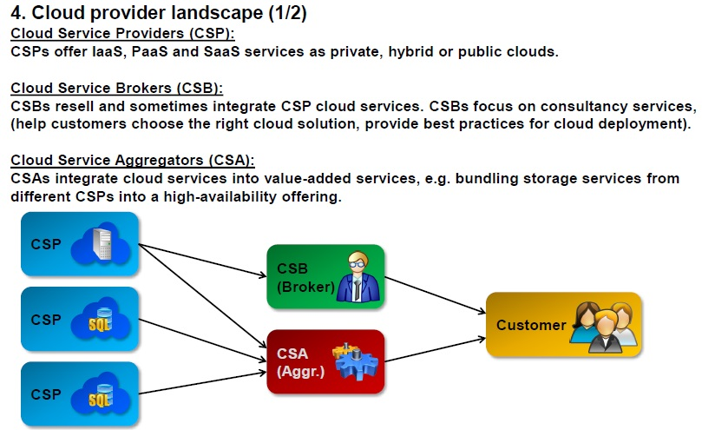
Landscape of providers: public vs private
Notes:
https://www.slideshare.net/PeterREgli/overview-of-cloud-computing-26076530

Slide 50
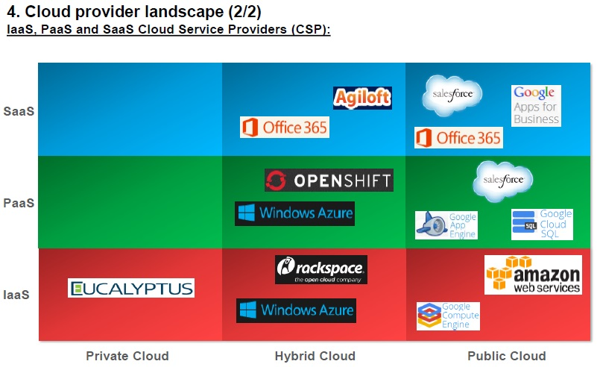
Landscape of providers: public vs private
Notes:
https://www.slideshare.net/PeterREgli/overview-of-cloud-computing-26076530

Slide 51
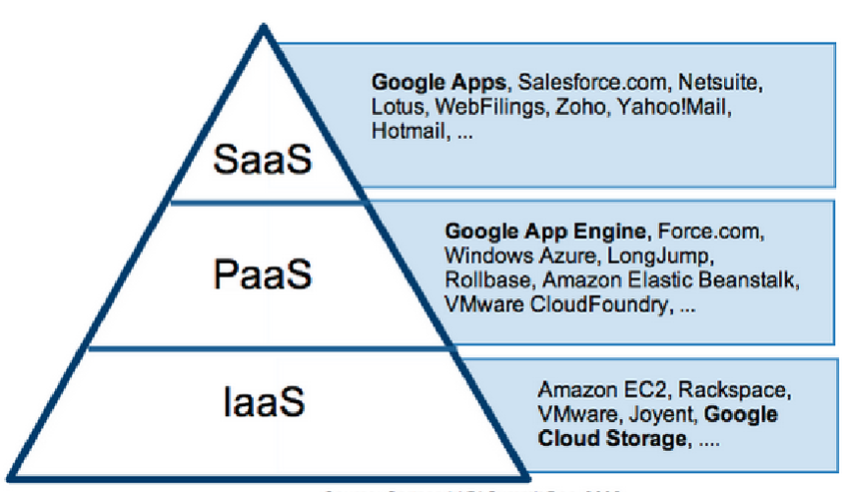
Cloud delivery model
Notes:
https://www.researchgate.net/publication/260192916_A_Seminar_Report_on_SECURITY_IN_CLOUD_COMPUTING_Prepared_by/figures

Slide 52
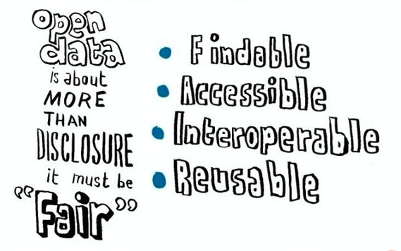
The end-game: when everything fals into place
Which is connected to reproducibility
Notes:
https://www.dtls.nl/fair-data/fair-data/
FAIR Data
The paper ‘The FAIR Guiding Principles for scientific data management and stewardship‘ is the first formal publication of the FAIR principles. In short, the FAIR Data Principles propose that all scholarly output should be:
Findable: easy to find for both humans and computers, with metadata that facilitate searching for specific datasets,
Accessible: stored for long term so that they can easily be accessed and/or downloaded with well-defined license and access conditions (open access when possible), whether at the level of metadata, or at the level of the actual data,
Interoperable: ready to be combined with other datasets by humans or computers,
Reusable: ready to be used for future research and to be further processed using computational methods.

Slide 53

Notes:
Developing a framework for digital objects in the Big Data to Knowledge
(BD2K) commons: Report from the Commons Framework Pilots
Workshop
http://www.sciencedirect.com/science/article/pii/S1532046417301016?via%3Dihub

Slide 54

Notes:
https://www.elixir-europe.org/platforms/data/core-data-resources

Slide 55

Notes:
https://www.elixir-europe.org/platforms/data/core-data-resources

Slide 56

Notes:
https://www.elixir-europe.org/platforms/data/core-data-resources

Slide 57

Sustainability: does the research community use the resources? Only if potential end-users are trained well …
Notes:
https://www.ncbi.nlm.nih.gov/pmc/articles/PMC5516217/pdf/f1000research-6-12660.pdf

